Slide 1


MACNY & Green Energy in the CNY Region
November 2023
Will Breitenbach, Luke Boyer
Jay Shankar, Darci Johal

Slide 2
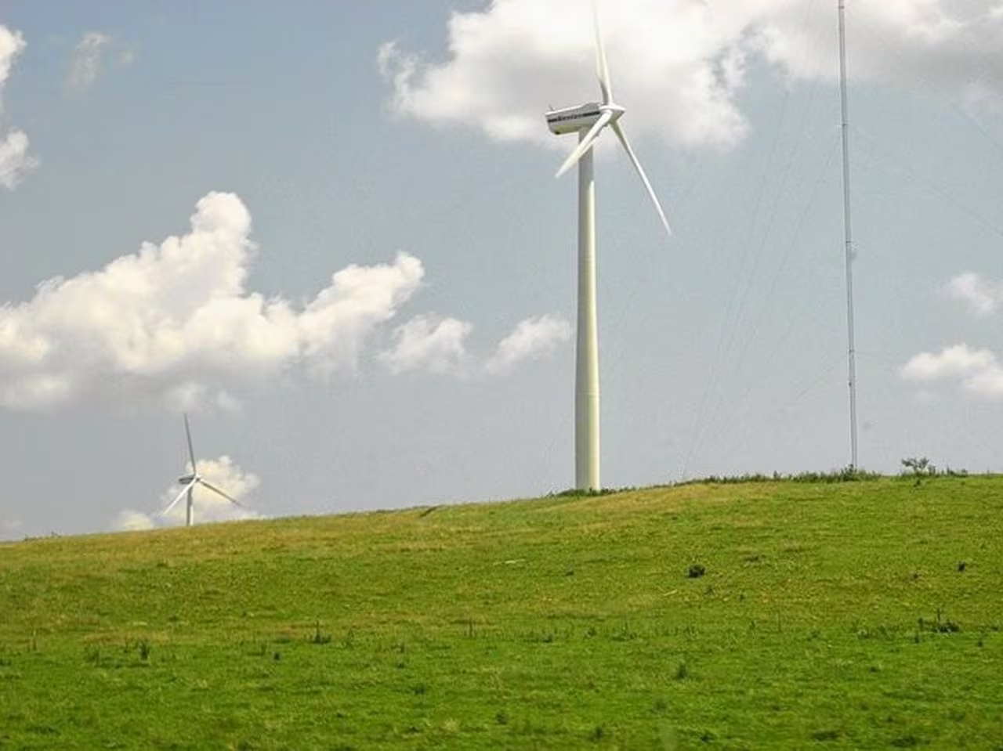
Agenda
Who is MACNY?
Survey Data
Recommendation to MACNY
Local Leaders in Sustainability
CNY Green Energy Projects
Conclusion

Slide 3
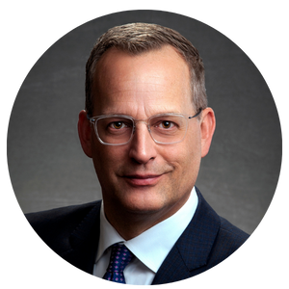
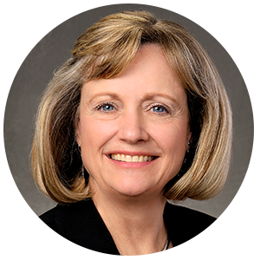
Who is MACNY?
Manufacturers Association of Central NY
300+ Member Companies
Offer Training, Networking Events, Energy Solutions, Workforce Development
Matt Geitner Director of Government Relations
Cindy Oehmigen Director, Energy & Corporate Services

Slide 4
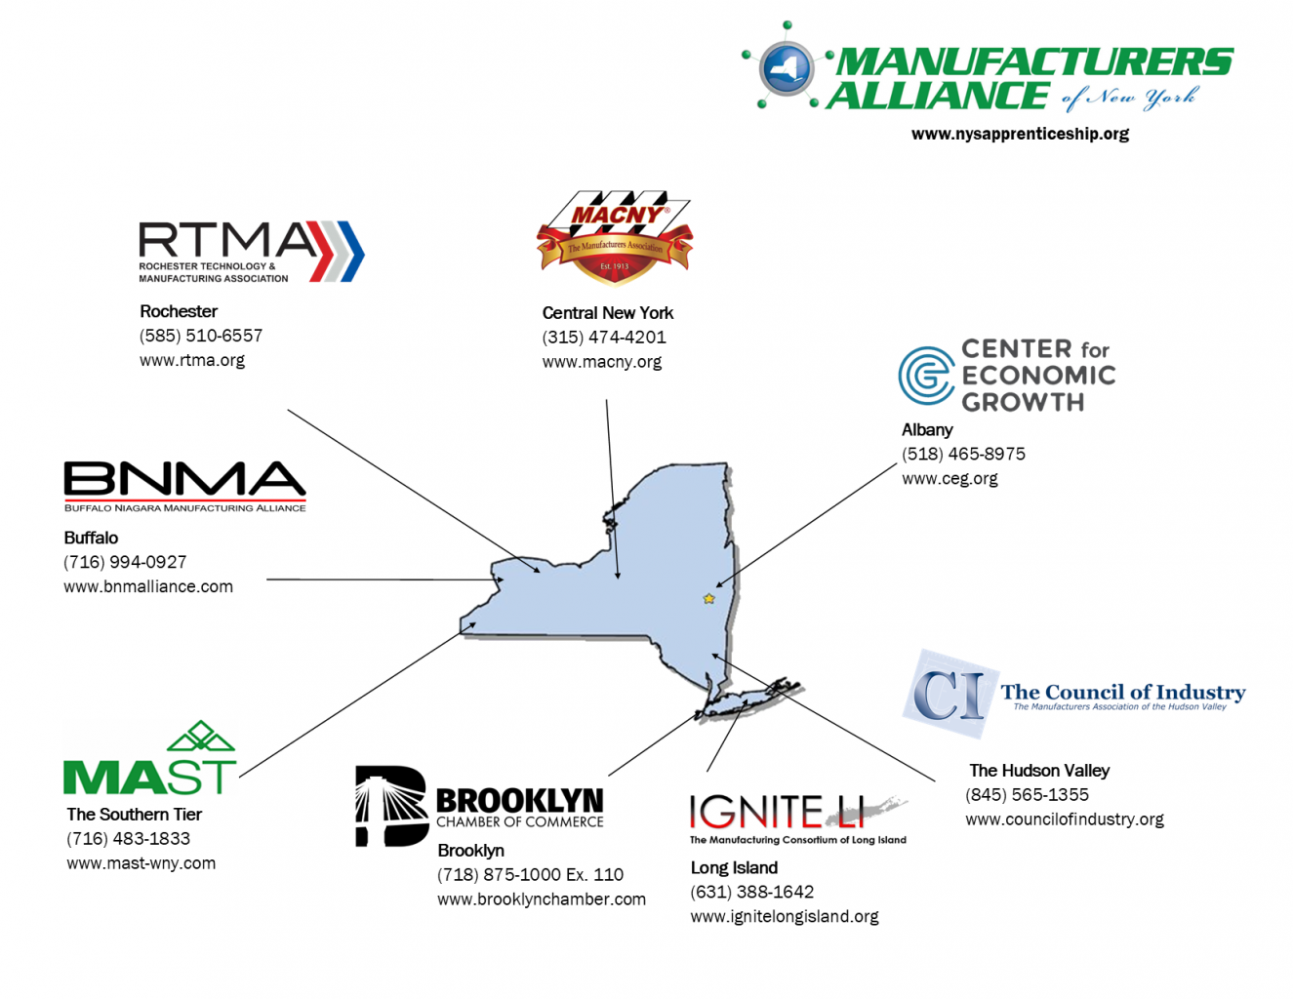
Manufacturers Alliance of NY

Slide 5
Survey Data
Bullet #1
Bullet #2
Bullet #3

Slide 6
MACNY Newsletter Recommendation
Bullet #1
Bullet #2
Bullet #3

Slide 7
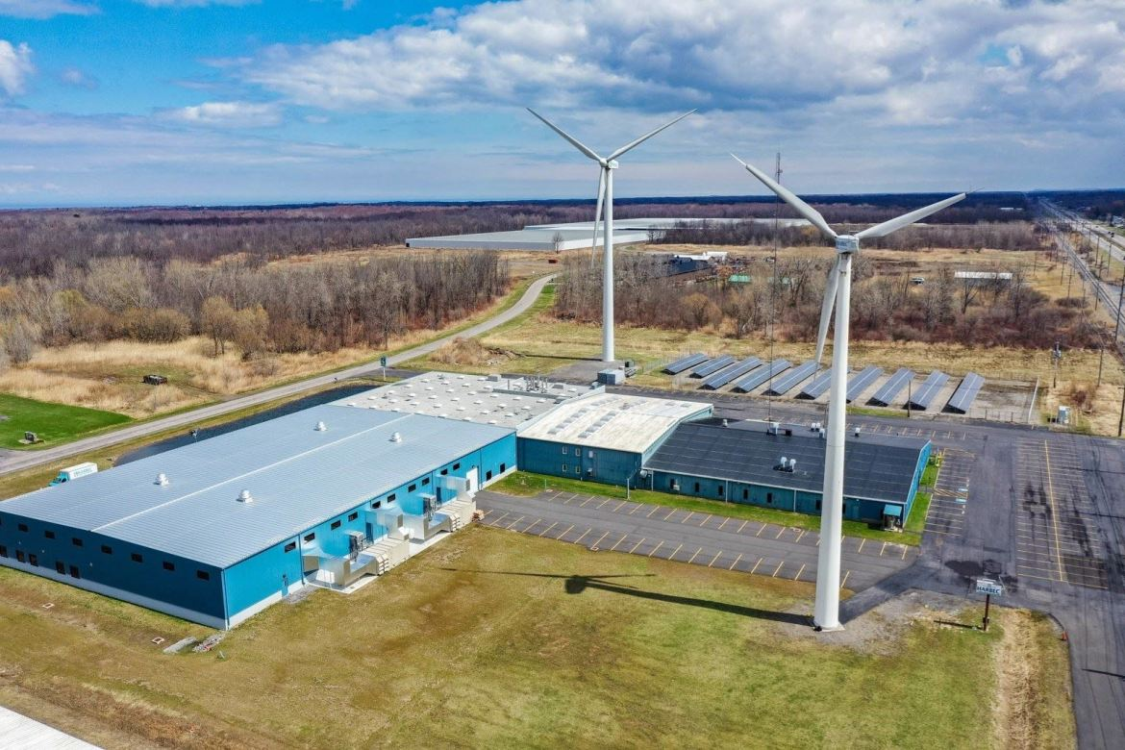
HARBEC – PRECISION MANUFACTURING COMPANY:
Harbec sources 60% of its energy from wind turbines, 20% from the CCHP system, and 20% from the electric utility.
Efficiently repurposes heat energy with its air-conditioning system.
Harbec's water-neutral practices contribute to sustainability by limiting potable water usage in manufacturing processes.
Awarded a grant from NYSERDA, it added eight turbines with a combined capacity of 820 kW.

Slide 8
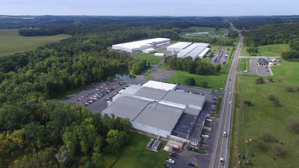
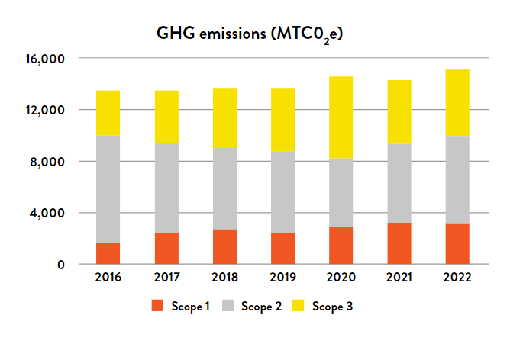
TESSY - PLASTIC PROCESSING COMPANY: (Top 20% with Score A-)
Efficient Design = Smaller Footprint, Where 8,817 Kg of CO2 emissions projected to save.
187.56 metric tons of Forest Stewardship Council-certified packaging were used.
Implement closed-loop water cooling systems to decrease water usage.
Over 86% of the waste was recycled or reclaimed.
49% reduction in GHG emissions intensity.

Slide 9

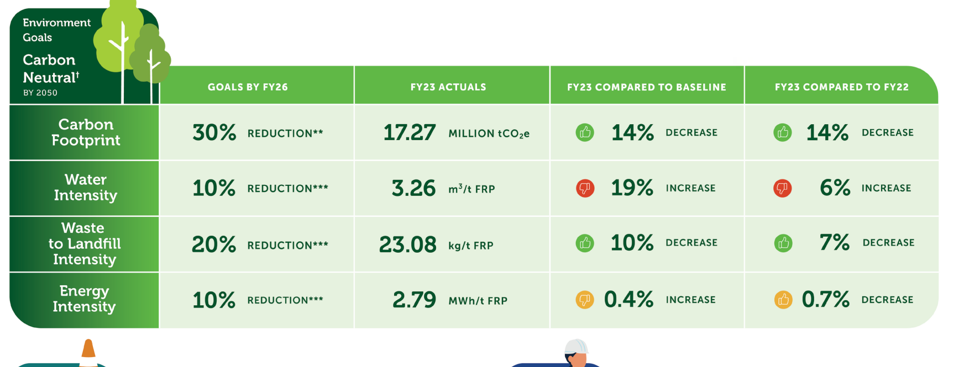
NOVELIS CORP - ALUMINUM SOLUTIONS AND RECYCLING:
Their key strategies include reducing carbon emissions by incorporating recycled aluminum.
With an impressive global average recycled content of 61%, it stands out as a leading recycler.
30% CO2 footprint reduction goal by 2026.
Reduce waste to landfill intensity by 20% by 2026.

Slide 10
NOVELIS CORP - ALUMINUM SOLUTIONS AND RECYCLING:
Their key strategies include reducing carbon emissions by incorporating recycled aluminum.
With an impressive global average recycled content of 61%, it stands out as a leading recycler.
30% CO2 footprint reduction goal by 2026.
Reduce waste to landfill intensity by 20% by 2026.

Slide 11
SOURCES:
https://www.plasticsmachinerymanufacturing.com/features/article/21136683/harbec-succeeds-in-carbonneutral-quest
Novelis-Sustainability-Report-2023.pdf
https://tessy.com/wp-content/uploads/2023/07/Tessy-2023-Sustainability-Report-V2.pdf

Slide 12
Green Energy Project #1 - Solar
Bullet #1
Bullet #2
Bullet #3

Slide 13
Green Energy Project #2 - Wind
Bullet #1
Bullet #2
Bullet #3

Slide 14
Hotel Skylar - Geothermal
Bullet #1
Bullet #2
Bullet #3

Slide 15
Conclusion - Recommendation
Subtitle 1 Goes Here
Subtitle 2 Goes Here
Bullet #1
Bullet #2
Bullet #1
Bullet #2

Slide 16
Title Goes Here (Example of Bar Graph in a Text Only Slide)

Slide 17
Title Goes Here (Example of a Pie Chart in a Text Only Slide)

Slide 18
Title Goes Here (Example of a Table Slide)
Column 1 | Column 2 | Column 3 | Column 4 | Column 5
Data point 1 | Data point 5 | Data point 9 | Data point 13 | Data point 17
Data point 2 | Data point 6 | Data point 10 | Data point 14 | Data point 18
Data point 3 | Data point 7 | Data point 11 | Data point 15 | Data point 19
Data point 4 | Data point 8 | Data point 12 | Data point 16 | Data point 20

Slide 19

Title Goes Here (Example of a Picture Only Slide)

Slide 20
Single Heading or Impact Statement Here (Example of Title Only Slide)

Slide 21
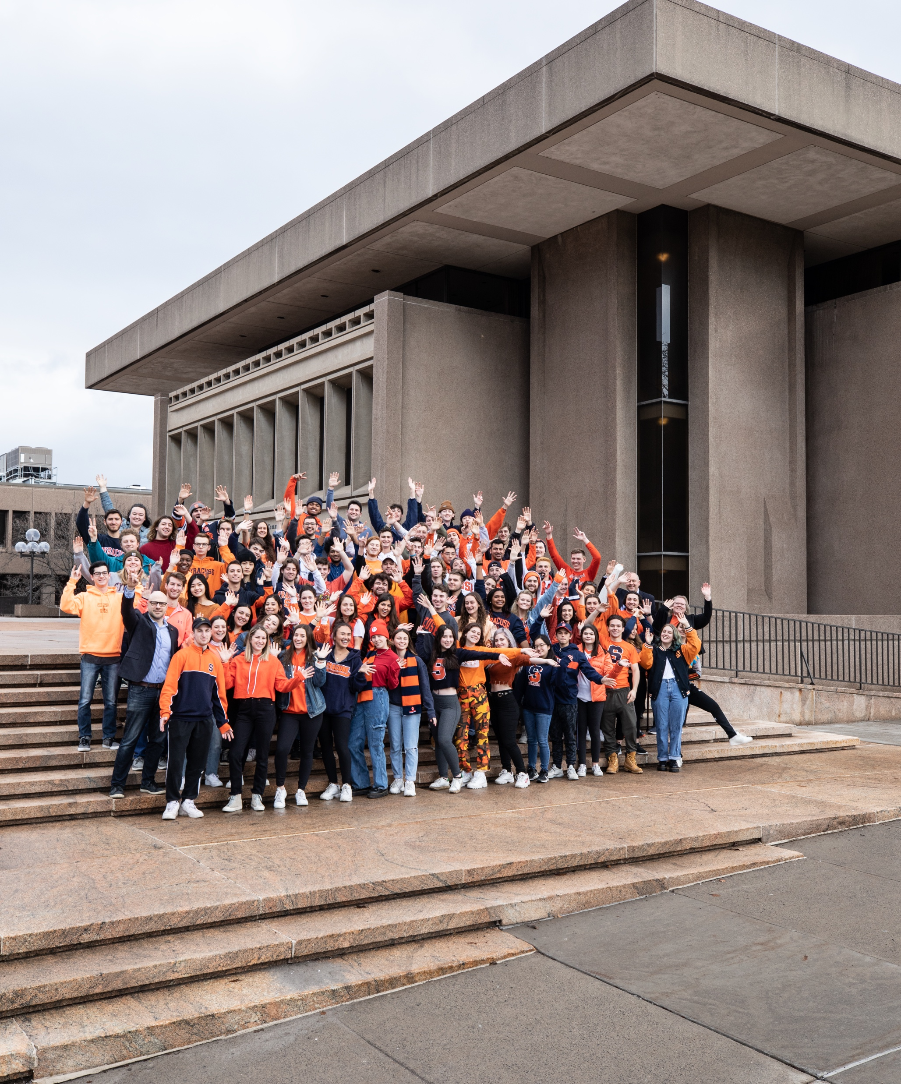
Section Title Here
Version one (with included image)

Slide 22

Section Title Here
Version two (with included image)

Slide 23

Section Title Here
Version one (with added image)

Slide 24
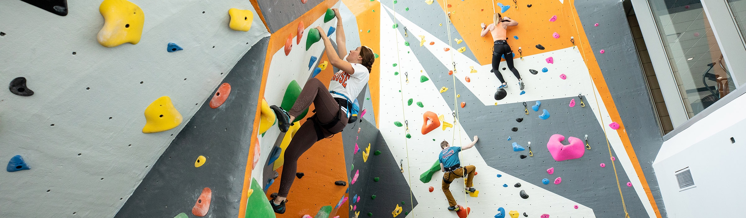
Section Title Here
Version two (with added image)

Slide 25
Closing Text
Your Name
Your Title
Your contact information

Slide 26
Closing Text
Your Name
Your Title
Your contact information

Slide 27
Closing Text
Your Name
Your Title
Your contact information

